Slide 1
Capacitive Touch Sensing
DorkbotPDX Workshop
Philip Odom
2014-06-29

Slide 2
The Agenda
Intro and get to know you
Demo kits
Capacitive sensing theory
Software set up
Building the proto board
Debugging and playing around

Slide 3
Introductions
Me==Philip Odom, Electrical Engineer
Worked with capacitive sensing >5 years (but not constantly)
Several toys and consumer products using low-cost capacitive touch sensing—PaperJamz!
Who are y’all?

Slide 4
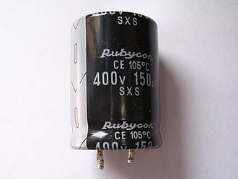
What’s a capacitor, anyway?
Two terminal device
Stores energy electrostatically
Two conducting plates with insulating separator
Electric field causes opposite charges to accumulate on plates

Slide 5
Capacitors are Everywhere
Capacitor == any two conductive objects with insulation in between
Electric fields cause charge to accumulate and redistribute on capacitor plates
You are a capacitor—or at least 1 plate
YOU
OTHER CONDUCT OBJECT

Slide 6
Capacitive Sensing Basics
Sensing circuit measures capacitance
Simple sensor is conductive plate connected to circuit
Sensor has base level of capacitance to other conductive nodes in system
System detects increase in capacitance when touched

Slide 7
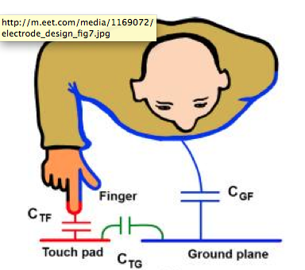
Circuit Model, You+Sensor
Everyone’s body has large surface area
Capacitive coupling between body and system all the time
Touch increases sensor capacitance, body+sensor in series with body+ground
“Ground” means all the other conductive nodes, not just GND

Slide 8
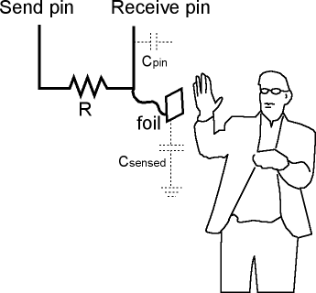
Our Demo, RC Circuit

Slide 9
Charge Time Measurement
Configure send pin as output high
Configure receive (sensor) pin as output low
Allow small settling time
Switch receive pin to input
Measure time required for input to change from low to high

Slide 10
Baseline Tracking
Need to track sensor level with no touch
Reset at power-on or after timeout
Tracks changes in base capacitance, adjusts slowly
“Net” sensor value is raw value minus baseline

Slide 11
Sensor as Momentary Switch
Software compares current net sensor value to threshold
If greater than threshold, switch is on; else it’s off
Hysteresis and debouncing typically used to prevent spurious events
Threshold determined empirically by construction

Slide 12
Get A Kit and Let’s Get Building!
Recommended build order:
Headers
1Meg resistors
1k and 270 resistors
Ground Wire
LEDs
Alligators clip to 270s, leave some exposed leads
6th alligator clips to ground, use a short stripped wire
It’s tight, but it’ll fit!

Slide 13
Drawing or Making Sensors
Use a #2 pencil
Draw pad to clip to at edge of paper
Draw touch pad and connecting trace
Make everything very dark for better conductivity
Test before taping
Once it’s working, put tape over sensor pad
They’re delicate!
Cut a ground plane from aluminum foil, place around sensors for better performance

